Slide 1

Universidad Nacional Mayor de San Marcos
Universidad del Perú. Decana de América
FACULTAD DE INGENIERIA GEOLÓGICA, MINERA, METALÚRGICA Y GEOGRÁFICA
ASIGNATURA: Calculo IV
TEMA: Variable separable y reducible a V.A
"
DOCENTE: HEIDI MARLENE CHUPAYO EVANGELISTA
ESTUDIANTE: Briceño Cárdenas, Marlon Gonzalo
TAREA –SEMANA 1
2021

Slide 2
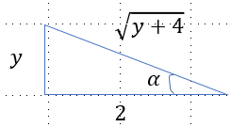


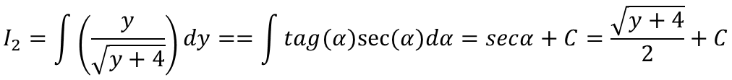
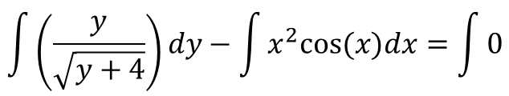





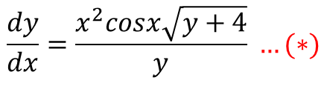


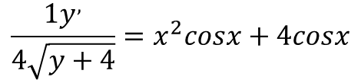
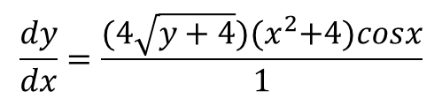
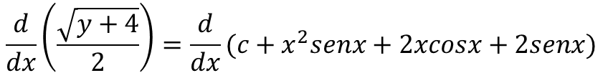
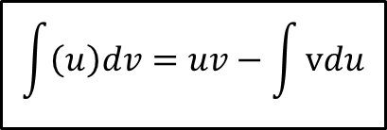
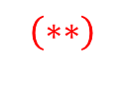
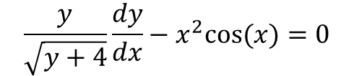


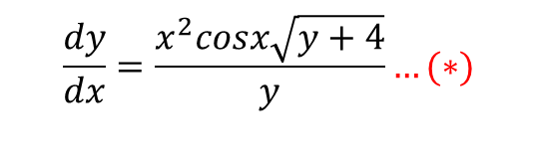

Ejercicio inventado:
$$\frac{y}{\sqrt{y+4}}=Sen(α)$$
$$dy=\sec^{2}{α}dα$$
$$\frac{y}{\sqrt{y+4}}dy−x^{2}cos⁡(x)dx=0$$
$$M\left(y\right)dy+N\left(x\right)dx=0$$
$$I_{2}$$
Ordenamos e integramos:
$$\frac{dy}{dx}=\frac{x^{2}cosx\sqrt{y+4}}{y} …(∗)$$
$$\int{\left(\frac{y}{\sqrt{y+4}}\right)dy}−\int{x^{2}cos⁡(x)dx}=\int{0}$$
$$I_{1}$$
$$I_{1}=\int{x^{2}cos⁡(x)dx}=x^{2}senx−2\int{xsenxdu}=x^{2}senx−2xcosx−2senx+C$$
$$u=x^{2}$$
$$\int{\left(u\right)dv}=uv−\int{vdu}$$
$$I_{2}=\int{\left(\frac{y}{\sqrt{y+4}}\right)dy}==\int{tag(α)sec⁡(α)dα}=secα+C=\frac{\sqrt{y+4}}{2}+C$$
$$v=senx$$
$$\frac{\sqrt{y+4}}{2}−x^{2}senx−2xcosx−2senx=C…(∗∗)$$
Comprobamos:[Comparamos el (*) y el (**)], Conclusión: no corresponden entre sí, no se puede igualar a una constante
$$\frac{y}{\sqrt{y+4}}\frac{dy}{dx}−x^{2}cos⁡(x)=0$$
$$M\left(y\right)\frac{dy}{dx}+N\left(x\right)=0$$
$$\frac{dy}{dx}=\frac{x^{2}cosx\sqrt{y+4}}{y}…(∗)$$
$$(∗)$$
$$\frac{d}{dx}\left(\frac{\sqrt{y+4}}{2}\right)=\frac{d}{dx}(c+x^{2}senx+2xcosx+2senx)$$
$$\frac{1y^{,}}{4\sqrt{y+4}}=x^{2}cosx+4cosx$$
$$\frac{dy}{dx}=\frac{(4\sqrt{y+4}){(x}^{2}+4)cosx}{1}$$
$$(∗∗)$$
$$…(∗∗)$$

Slide 3




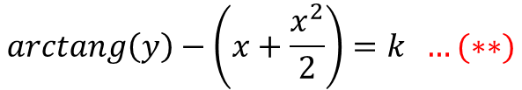
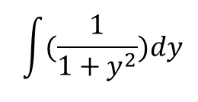


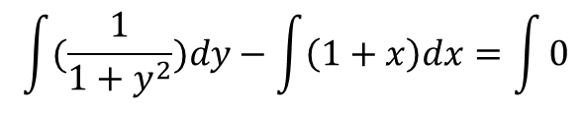



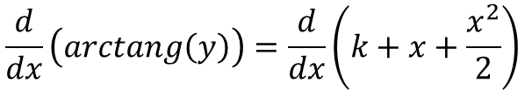


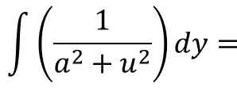

Ordenamos:
$$\frac{dy}{dx}=1+x+\left(1+x\right)y^{2}$$
$$\frac{dy}{dx}=\left(1+y^{2}\right)\left(1+x\right)…(∗)$$
$$\int{\left(\frac{1}{a^{2}+u^{2}}\right)dy=}$$
$$\frac{1}{a}arctang(\frac{u}{a})$$
$$(\frac{1}{1+y^{2}})dy−\left(1+x\right)dx=0$$
$$M(y)dy−N\left(x\right)dx=0$$
Integramos:
$$\int{(\frac{1}{1+y^{2}})dy}−\int{\left(1+x\right)dx}=\int{0}$$
$$arctang\left(y\right)−\left(x+\frac{x^{2}}{2}\right)=k …(∗∗)$$
$$\int{(\frac{1}{1+y^{2}})dy}$$
Comprobamos: [Comparamos el (*) y el (**)]
(*)
$$(\frac{1}{1+y^{2}})\frac{dy}{dx}−\left(1+x\right)=0$$
$$M\left(y\right)\frac{dy}{dx}−N\left(x\right)=0$$
$$y^{,}=\left(1+x\right)\left(1+y^{2}\right)…\left(∗\right)$$
$$\frac{d}{du}\left(arctang\left(u\right)\right)=\frac{u^{,}}{1+u^{2}}$$
(**)
$$\frac{d}{dx}\left(arctang\left(y\right)\right)=\frac{d}{dx}\left(k+x+\frac{x^{2}}{2}\right)$$
$$\frac{y^{,}}{1+y^{2}}=1+x$$
$$\frac{d}{dx}\left(arctang\left(y\right)\right)$$
$$y^{,}=\left(1+x\right)\left(1+y^{2}\right) …(∗∗)$$

Slide 4

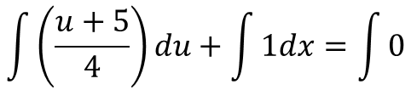






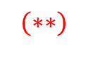

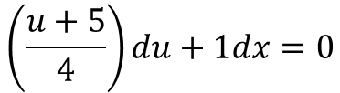


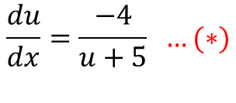







Ordenamos:
$$\frac{dy}{dx}=\frac{y−x+1}{y−x+5}$$
$$y−x=u→y=u+x$$
…(I)
$$\frac{du}{dx}=\frac{−4}{u+5} …(∗)$$
$$\frac{du}{dx}+1=\frac{u+1}{u+5}$$
$$\left(\frac{u+5}{4}\right)du+1dx=0$$
$$M\left(y\right)dy+N\left(x\right)dx=0$$
Integramos:
$$\int{\left(\frac{u+5}{4}\right)du}+\int{1dx}=\int{0}$$
$$\frac{{\left(u+5\right)}^{2}}{8}+x=k$$
$$\frac{{ u}^{2}}{8}+\frac{25}{8}+\frac{5u}{4}+x=k$$
$$\frac{{(y−x)}^{2}}{8}+\frac{25}{8}+\frac{5y−5x}{4}+x=k$$
$$8x(\frac{{\left(y−x\right)}^{2}}{8}+\frac{5y−5x}{4}+x=C)$$
$${\left(y−x\right)}^{2}+10y−2x=C↔{\left(u+5\right)}^{2}+8x=C…(∗∗)$$
Comprobamos:[Comparamos el (*) y el (**)]
$$\frac{du}{dx}=\frac{−4}{u+5}$$
$$M\left(y\right)\frac{dy}{dx}+N\left(x\right)=0$$
$$\frac{du}{dx}=\frac{−4}{u+5} …(∗)$$
$$(∗)$$
$$(∗∗)$$
$$\frac{d}{dx}{\left(u+5\right)}^{2}=\frac{d}{dx}(c−8x)$$
$$\frac{2(u+5)du}{dx}=−8$$
$$\frac{du}{dx}=−\frac{8}{2(u+5)}$$
$$\frac{du}{dx}=\frac{−4}{\left(u+5\right)} …(∗∗)$$

